Slide 1



Course: Image Processing 31651
Assignment #24
Pixel to Pixel Operations (Part 4) – version 2
1
Photo of the student | Shorten Name | ID (4 last digits)
 | shienfeld | 1950 | Student #1
 | pony | 2210 | Student #2
 | akimov | 7939 | Student #3
Photo of the student | Shorten Name | ID (4 last digits)
 | shienfeld | 1950 | Student #1
 | pony | 2210 | Student #2
 | akimov | 7939 | Student #3

Slide 2
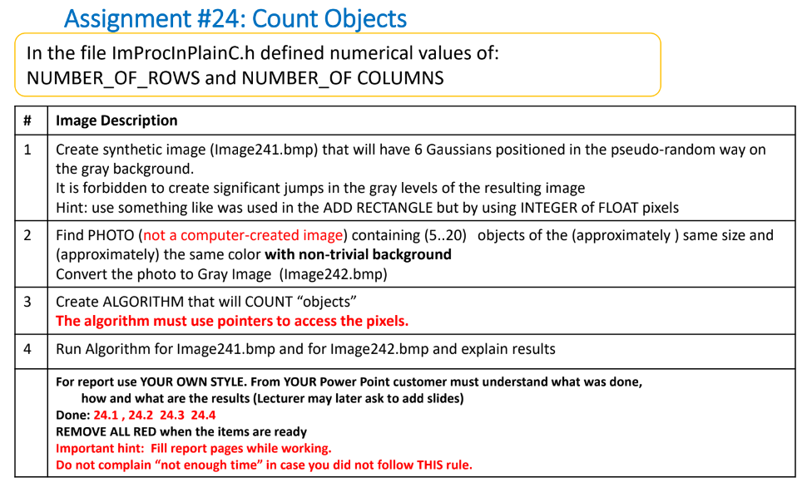
Pay attention : due to the complexity of the code and the complexity of the order of operations in the code – the functions will be explained first and only after that the connectivity to the task will be explained. Every function will be explained as an “isolated part” of the entire program.

Slide 3
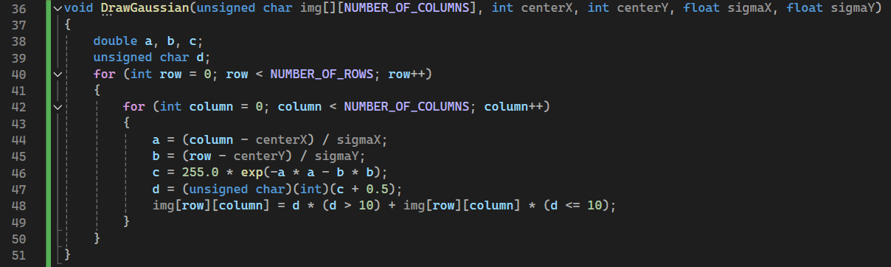
24.1 – “DrawGaussian” function
The DrawGaussian function is designed to add a Gaussian distribution to an image at specified coordinates.
For each pixel located at (row, column), the function calculates the value of the Gaussian distribution at that point.
a and b are the normalized distances from the center of the Gaussian in the x and y directions, respectively.
The Gaussian value c is then calculated using the formula for a 2D Gaussian distribution:
d is the Gaussian value rounded to the nearest integer.
The function updates the pixel value at (row, column) in the image array img:
If the calculated Gaussian value d is greater than 10, the pixel value is updated to d. If d is less than or equal to 10, the pixel value remains unchanged.

Slide 4
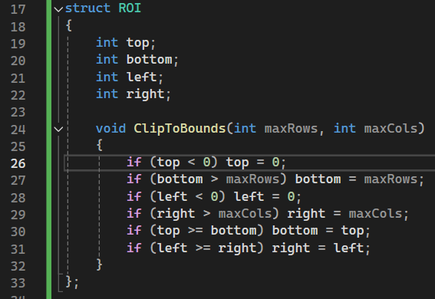
24.2 – “ROI (region of interest)” struct
The primary purpose of the ROI struct is to define a rectangular area within an image where certain operations will be applied.
This allows focusing on specific parts of the image rather than processing the entire image.
void ClipToBounds is a method to ensure the ROI is within the bounds of the image. It adjusts the top, bottom, left, and right properties to make sure they do not exceed the image dimensions.
Summary : we created the ROI as a useful tool for later counting operation (of objects or gaussians). In the next slides the usefulness of the ROI will be clarified!

Slide 5
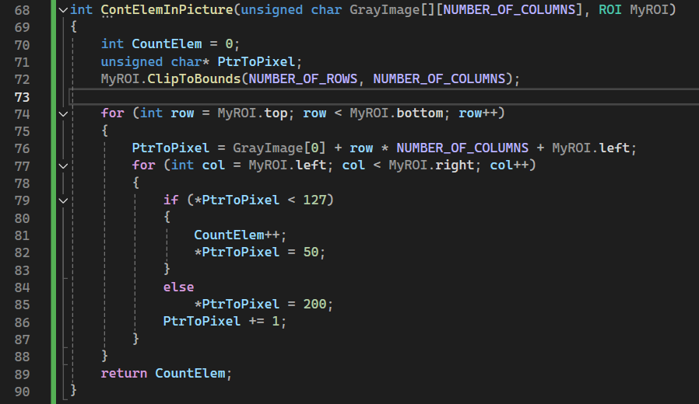
24.3 – “ContElemInPicture” function
This function is designed to count elements in a specified region of interest (ROI) in a grayscale image and to mark these elements and the background.
לבדוק
The function counts the number of elements (pixels) within a specified ROI in a grayscale image where the pixel values are below a certain threshold (127 in this case).
It also marks the pixels that are considered elements and those that are considered background.
Pay attention : pixelPtr is declared as a pointer to traverse the pixel values in the image. All the operations will be applied on that pointer.

Slide 6
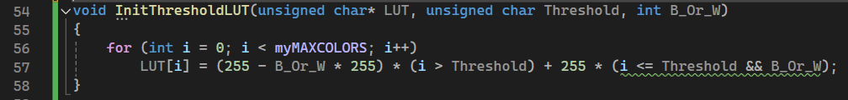
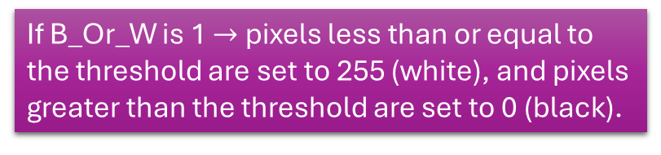
24.4 – “InitThresholdLUT” function
The InitThresholdLUT function initializes a Lookup Table for thresholding a grayscale image.
The LUT is used to map the pixel values based on a specified threshold, either making them black or white depending on whether they are above or below the threshold.
Pay attention – one of the input of the function is a pointer to the LUT which was defined as global.
B_Or_W is a flag that determines the output value for pixels based on the threshold
If B_Or_W is 1 $→$ pixels less than or equal to the threshold are set to 255 (white), and pixels greater than the threshold are set to 0 (black).
If B_Or_W is 0, pixels less than or equal to the threshold are set to 0 (black), and pixels greater than the threshold are set to 255 (white).

Slide 7
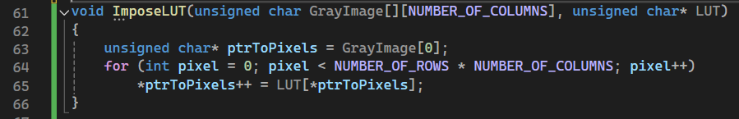
24.5 – “ImposeLUT” function
After defining the LUT – we need to apply the LUT on the gray image.
ptrToPixels is initialized to point to the first pixel of the image.
Since GrayImage is a 2D array, GrayImage[0] points to the first row, and ptrToPixels thus points to the first pixel in that row.

Slide 8
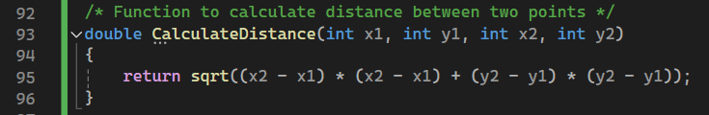
24.6 – “CalculateDistance” function

Slide 9
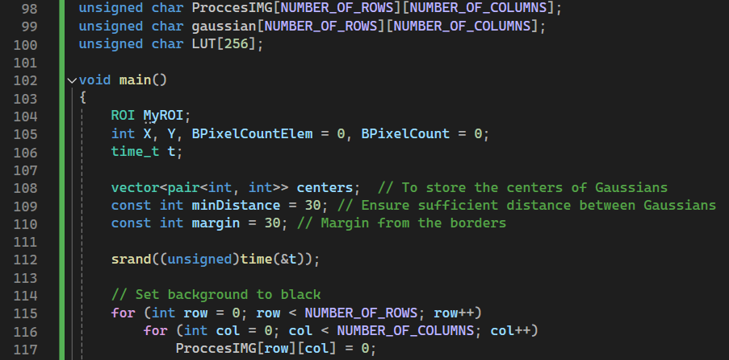
24.6 – “main” function – part 1

Slide 10
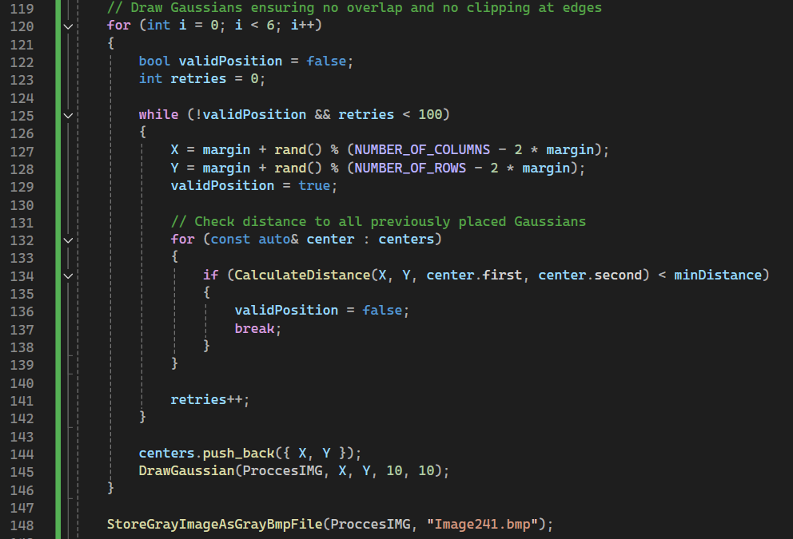
24.6 – “main” function – part 2

Slide 11
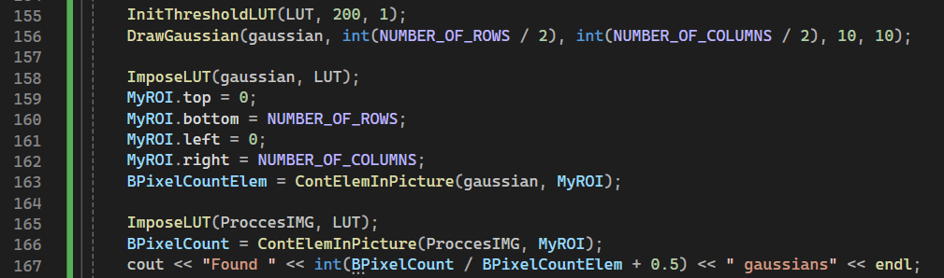
24.6 – “main” function – part 3

Slide 12
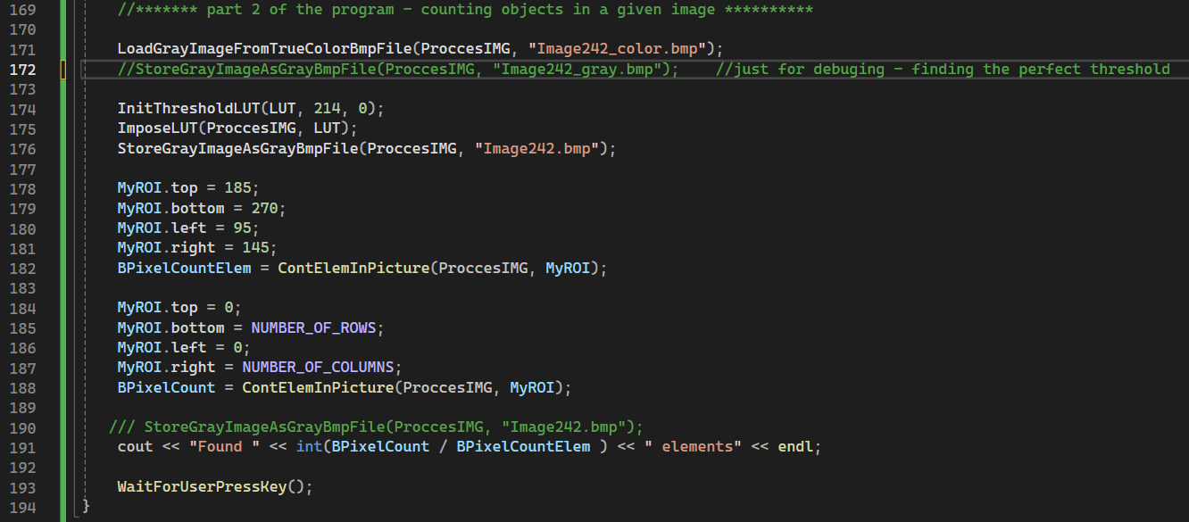
24.6 – “main” function – part 4

Slide 13
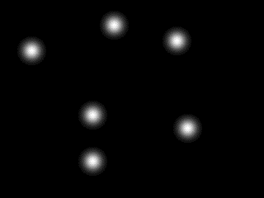


24.7 – created images and the counting results – part 1
Image241.bmp
The printing of the program indicate that 6 gaussian elements were found!
In addition – the profilers confirm that true gaussians were created.
Pay attention that I made sure that the created gaussians will be independent – AKA no overlapping or clipping – for preventing any chance of wrong counting!
This is the number I demanded!

Slide 14
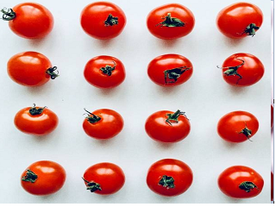
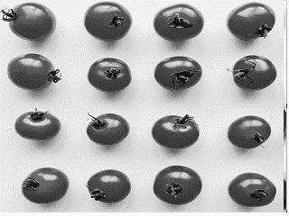
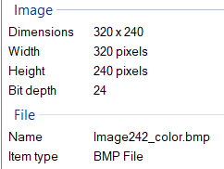
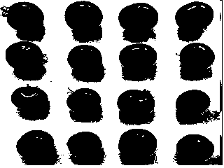
24.7 – created images and the counting results – part 2
Image242_color.bmp
Image242_gray.bmp
input
This is the result after applying the threshold algorithm– we did it for easier understanding of how to count the objects and how to distinguish the element from the background.

Slide 15
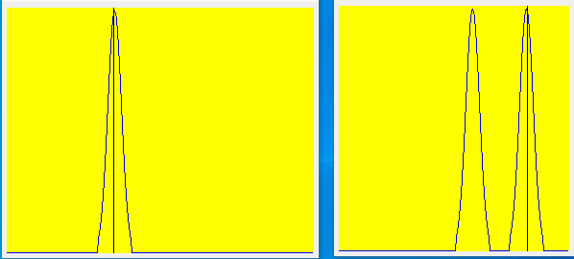
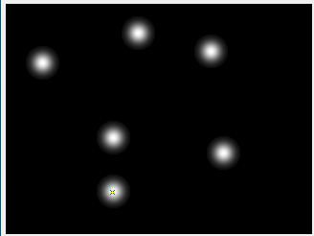
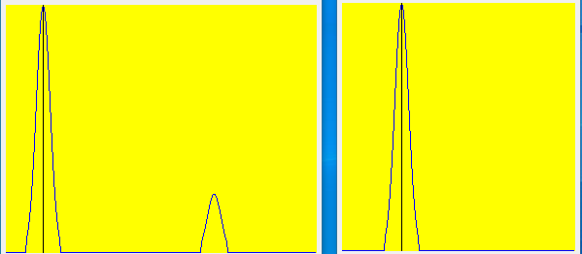
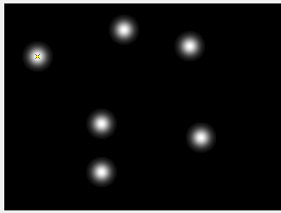
24.8 – created images' profiles– part 1
Inspection points

Slide 16
24.8 – what did we learn?
We learned how to count similar objects with similar shape and color in a photo using binary threshold method (under known background)
2. We learned how to use uniform distribution for getting random values
3. We learned how to create random gaussians

